Slide 1


Chapter 2
Basic Concepts and Conventions
Michael Fowler
Chemical Engineering
University of Waterloo
Waterloo, Ontario, Canada
January 2010

Slide 2
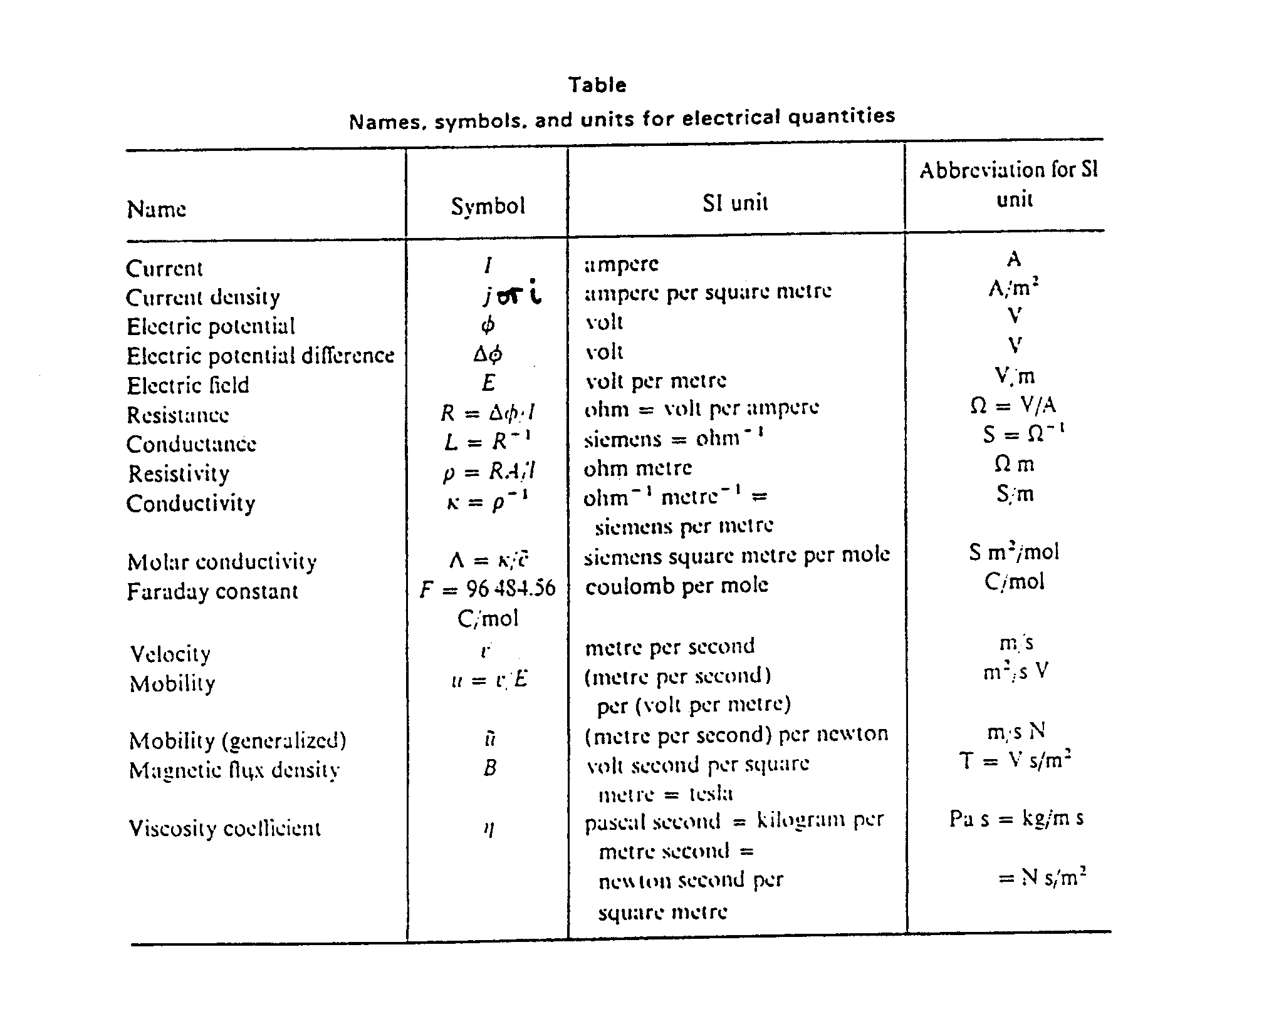

Slide 3
Electric Current
Whenever electric charges move, an electric current is said to exist
The current is the rate at which the charge flows through a certain cross-section
For the current definition, we look at the charges flowing perpendicularly to a surface of area A

Slide 4
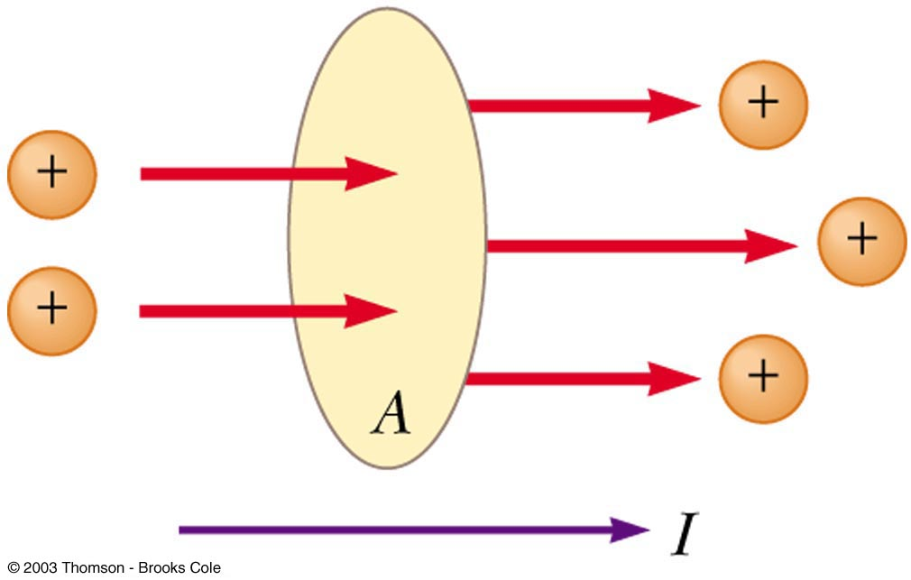
Definition of the current:
Charge in motion through an area A. The time rate of the charge flow through A defines the current (=charges per time):
I=ΔQ/Δt
+
-
It has the units of coulombs/sec, or amperes (amps). This is analogous to fluid flow rate through a pipe.
Units: 1 ampere = 1 coulomb/second
SI unit of the current: Ampere

Slide 5
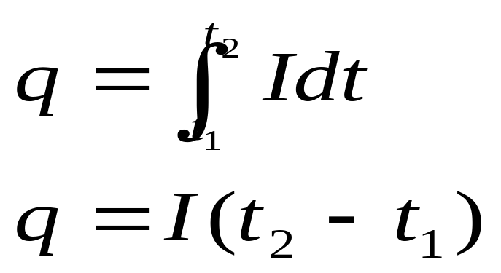
Electric Current, cont
The direction of current flow is the direction positive charge would flow
What is the total charge q (in coulombs) passed by a circuit over a period of time from t₁ to t₂?
If I is constant

Slide 6
Current density
The current per unit cross-section is called the current density i:
i=I/A
units of amp m⁻²
where A = electrode area normal to the flow of charge

Slide 7
Example:
An 18-gauge copper wire (diameter 1.02 mm) carries a constant current of 1.67 A to a 200 W lamp. The density of free electrons is 8.5×10²⁸ per cubic meter. Find the magnitudes of the current density
A=d²π/4=(0.00102 m)²π/4=8.2×10⁻⁷ m²
i=I/A=1.67 A/(8.2×10⁻⁷ m²)=2.0×10⁶ A/m²

Slide 8
Potential or Voltage
The voltage across a cell is the driving force pumping electrons through the circuit and is a measure of the energy difference of electrons at the two electrodes of a cell.
Potential is analogous to pressure drop in fluid flow.

Slide 9
Types of electrochemical cells
There are two basic types of electrochemical cells:
electrolytic -utilizes electrical energy to drive electrochemical reactions, that would not otherwise occur.
eg., chloro-alkali cell, electroplating
galvanic - spontaneous electrochemical reactions generate a flow of electrons, eg., battery, corrosion, electroless plating

Slide 10
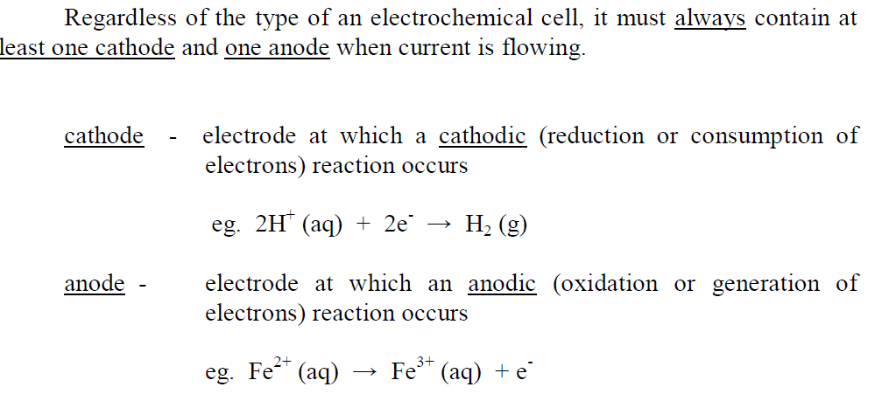
Types of Electrode and Electrode Reaction (2.3)

Slide 11
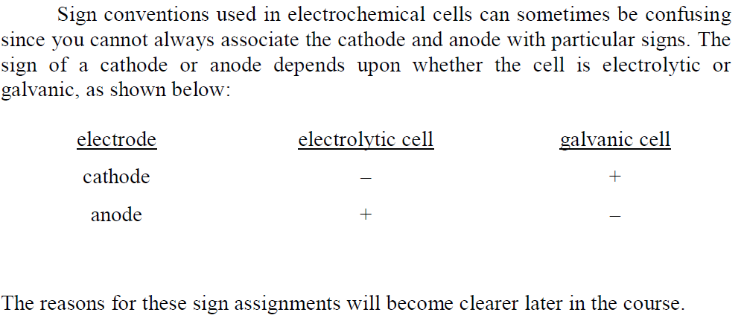
sign conventions

Slide 12
N.B. consider cell containing single anode and cathode
total current I passing through cell
= magnitude of current I passing through anode
( I_{anode} )
= magnitude of current I passing through cathode
( I_{cathode} )
_
I
+
anode
cathode
I
A_{anode}
I
A_{cathode}

Slide 13
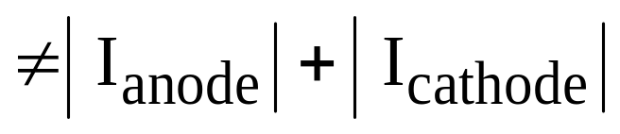

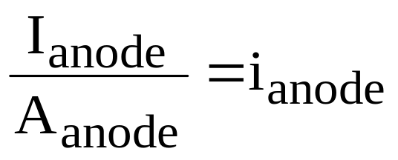




total current
total current =
anodic current density =
cathodic current density =
N.B. Although , is not necessarily equal to since electrode areas might differ.
What does “-” and “+” signs means?
Electrode with “+” sign has the higher or more positive potential than electrode with “-” sign.

Slide 14
Mode of operation of an electrolytic cell
Both electrolytic and galvanic cells can be operated in one of two ways:
galvanostatic mode - cell is operated under conditions whereby current is controlled; however, the voltage across the cell cannot be simultaneously controlled, only monitored.
potentiostatic mode -cell is operated under conditions whereby the cell potential is controlled. At the same time, the current cannot be controlled and can only be monitored.

Slide 15
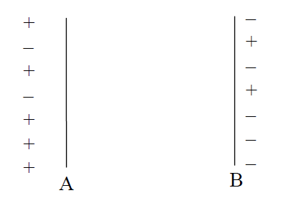
What is the Physical Picture of Electrical Potential?
Let’s consider the potential associated with charging two plates. To do this, we must go back to Coulomb’s Law - i.e., charges with opposite sign attract, charges with same sign repel.
Let’s say we have two parallel plates separated by a gap. We then charge the plates to an equal and opposite sign.
Plate A is positively charged, ie., it contains more positive charge carriers than negative carriers
Plate B is negatively charged.
Since this separation of charge opposes tendency toward electroneutrality, energy must be put into the system to charge the plates.

Slide 16
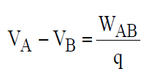
electrical potential is associated with work required to move charges.
Now, if we want to further charge the plates by moving a positive charge q from plate B (negative) to plate A ( positive), this will require work W_{AB} to be done on the system.
We define the voltage drop or potential drop between A and B in terms of the work W_{AB} to move a charge q from B to A, i.e.,

Slide 17
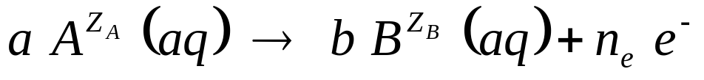


FARADAY’S LAW
Faraday’s Law relates electronic charge produced to mass reacted in an electron transfer reaction. Consider the general half-cell reaction occurring at a single electrode.
where a , b and n_{e} are stoichiometric coefficients; Z_{A} and Z_{B} are charges
how much electronic charge Δq is transferred during
production of Δn_{B} moles of ?
number of electrons transferred to produce b moles of
= n_{e} N_{av} N_{av} is Avagadro’s number

Slide 18

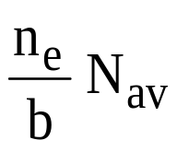
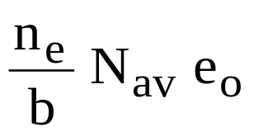
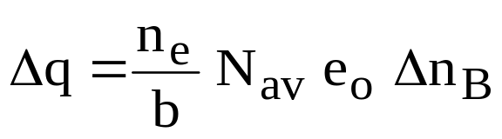
number of electrons transferred per mole of
produced =
total charge of electrons transferred per mole of
produced =
e₀ ≡ electronic charge =
∴ total charge Δq transferred to produce Δn_{B} moles of
is the elementary charge or the magnitude of the charge of an electron.

Slide 19
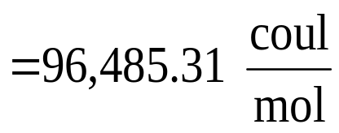
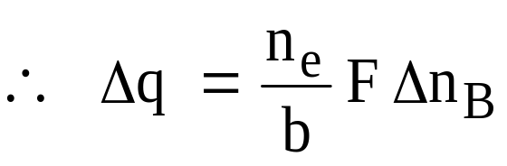
now, N_{av} e_{o} is a universal constant given the name Faraday constant F
charge due to an
Avagadro’s number
of electrons
1
1st form of Faraday’s Law
F ≡ N_{av} e_{o} = (6.02214 × 10²³ mol⁻¹) (1.60218 ×10⁻¹⁹ coul)

Slide 20
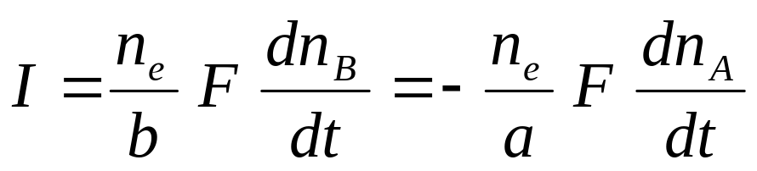
2nd form of Faraday’s Law
See Blackboard

Slide 21
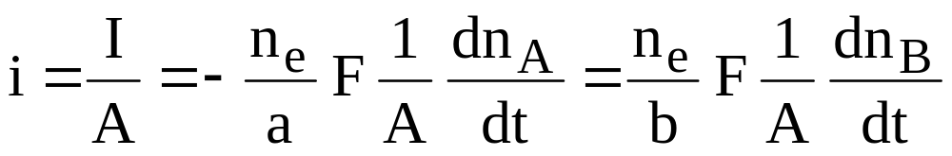
Thus, in a operating cell, total current flowing through the anode is positive, while the total current flowing through the cathode is negative, but both are the same in magnitude. When discussing an operating cell, this is understood and we usually speak only of the magnitude of the current flowing through the cell.
However, when considering what occurs at a single electrode, sign of current can be important the
∴ current density

Slide 22
Faraday’s law (alternate statement)
“The number of moles of material oxidized or reduced at an electrode is related by the stoichiometry of the electrode reaction to the amount of electricity passed through the cell.”
Simply stated:
1 mole e- → 1 mole Ag⁺
→ ½ mole Cu²⁺
→ 1/3 mole Al³⁺
Remember:
Charge of 1 mole e⁻ = 1 F = 96,485 C
I=Q/t
Current (Amperes) Equals Charge passed (Coulombs) per Unit of Time (Seconds)

Slide 23
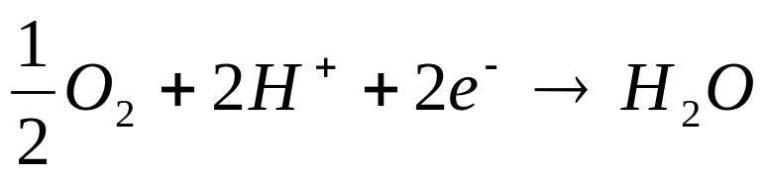
Examples
Apply the Faraday’s law in the followed reactions:
H₂ 2H⁺ + 2e⁻
⁽²⁾
⁽³⁾

Slide 24
Current Efficiency
In many cases, more than one electrode reaction occurs simultaneously on a single electrode. These reactions will occur as parallel competitive processes.the total current is split between these reactions.
See Graphic pdf

Slide 25
ENERGY REQUIREMENT
if a cell is operating at a total current I_{cell} and cell voltage V_{cell} (total voltage drop between cathode and anode), then
power required or power generated = V_{cell} I_{cell}
(electrolytic cell) (galvanic cell) use I_{cell} not i_{cell}
NOTE: 1 amp-volt = 1 Js⁻¹ = 1 W
electrical energy expended (or generated) over time from 0 to t is

Slide 26
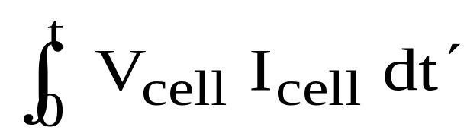
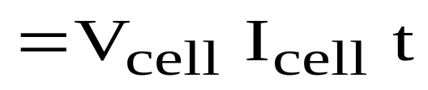
energy required or generated =
(if V_{cell} and I_{cell}
are constant)
We want to minimize this in an electrolytic cell and maximize it in a galvanic cell
A useful measure of efficiency of an electrolytic process is:
Energy Requirement per Unit Weight of Product Produced
(This is NOT ‘current efficiency’).

Slide 27
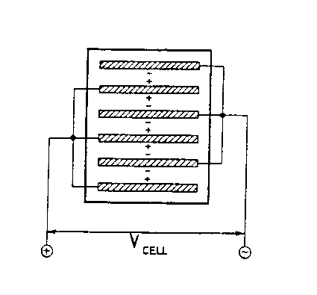
Electrical Connections in Multi-Electrode Cells
Two type of electrical connections are used: monopolar and bipolar. These can be used in both electrolytic and galvanic cells.
monopolar connection
The older and still commonly used method.
All cathodes are suspended from a common conducting busbar; all anodes are suspended from another busbar.
Thus, all cathodes are kept at one potential and all anodes at another potential. The total current is distributed between each cathode – anode pair

Slide 28
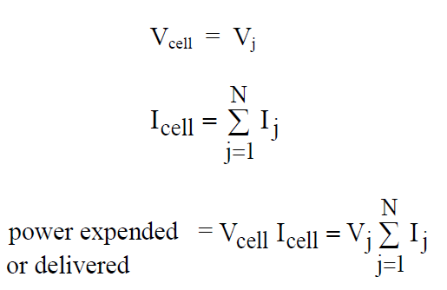
  V_{j} = voltage drop between each anode face and each cathode face
  I_{j} = current flowing between each anode face and each cathode face
  N = number of anode faces (or cathode faces) through which current flows

Slide 29
Note: In this case, a face is one side of an electrode sheet. Also, in this case. both sides of each electrode are involved in electrode reactions, except for end electrodes. So, in the above example, N = 5.
Both sides of each electrode have the same polarity. This is the origin of the term “monopolar connection”.

Slide 30
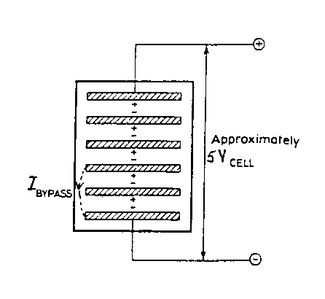
Bipolar Connection
Bipolar connection requires only two external electrical contacts to the two end electrodes
All electrodes are hooked up together in series. There will be a continual drop in potential from electrode-to-electrode on going from the (+) terminal to the (−) terminal
N.B. - One side of each electrode will act as the cathode for one cathode-anode; the other side will act as the anode for the next cathode-anode. (Hence, the term bipolar)

Slide 31
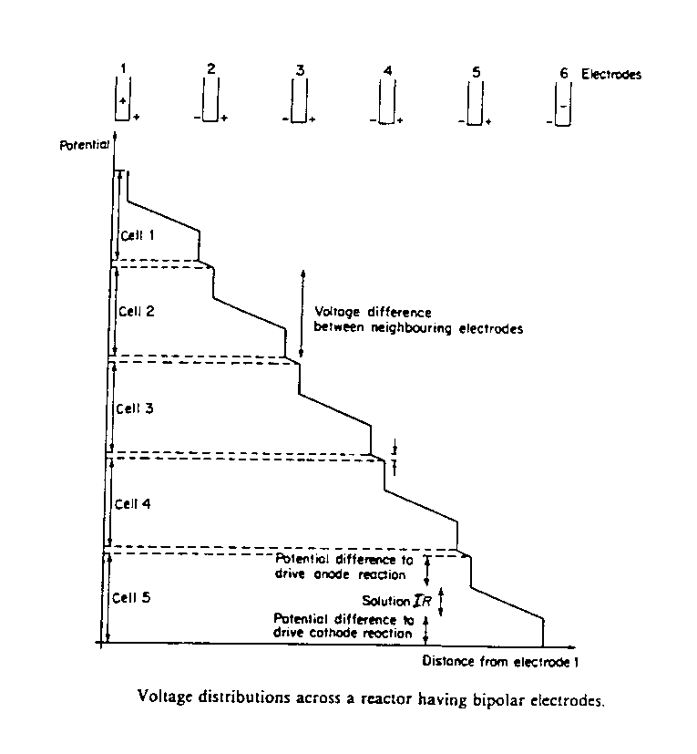
Shown below is the voltage distribution across a cell connected bipolarly.
A potential drop large enough to drive the process exists across the electrolyte from one electrode to the next. A very small IR drop will exist through each electrode. Thus, one side of each electrode is at a slightly higher potential than the other.

Slide 32
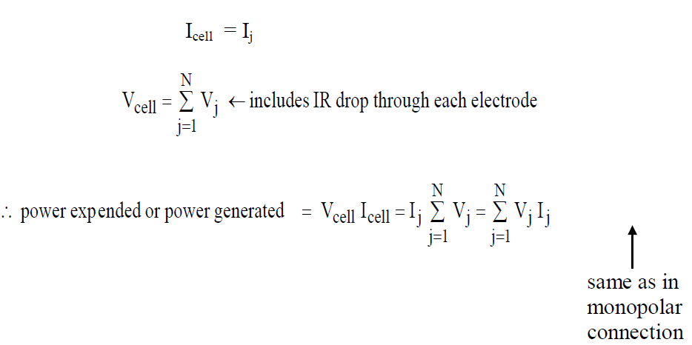
For a bipolar connection,
Bipolar cell operates at low current, high voltage.
Monopolar cell operates at high current, low voltage

Slide 33
Advantages of bipolar connection
1. Fewer electrical connections (less IR drop for hardware)
2. Current path through the electrode in a monopolar connection is along the length of the electrode. Current path through a bipolar electrode is only through its thickness. This increases IR drop in monopolar cell compared to a bipolar one.
Disadvantages of bipolar connection
1. A small leakage of current, called “bypass” current, can occur (see figure on previous page), in which current does not flow between each cathode-anode pair. Instead, it bypasses one and skips to the next. This increases the IR drop in electrolyte.

Slide 34
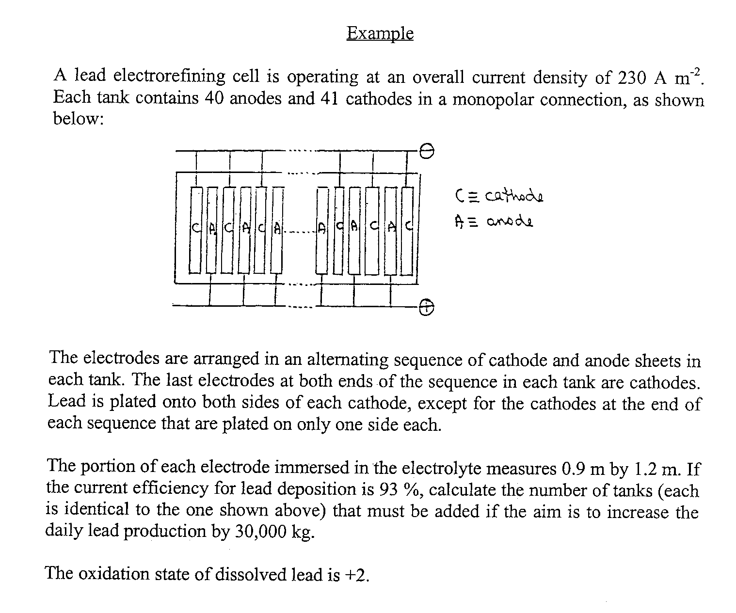

Slide 35
CSTR Model for Electrochemical Reactors
As with chemical reactions, we can set up a CSTR model for electrochemical reactions. Let’s consider the simple example of metal plating.

Slide 36
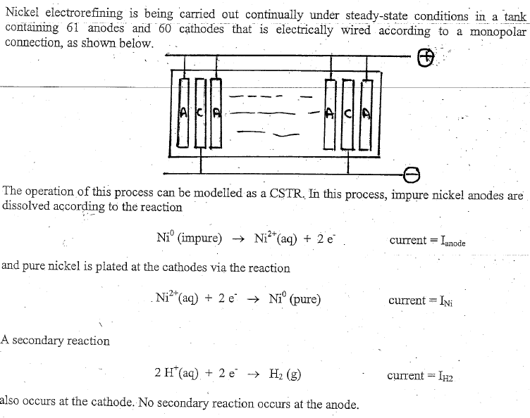
Nickel Plate Example
Continued next slide

Slide 37
